Slide 1
High Availability of Distributed application based on Container migration
Nagthej Manangi Ravindrarao
Qicang Qiu

Slide 2
Overview of presentation
Architecture Overview
Web application (Hello world)
Checkpoint & Restore (CRIU)
Container migration
Discovery service consul
High Availability
Nvidia-DIGITS container
Application part
Learnings
References

Slide 3
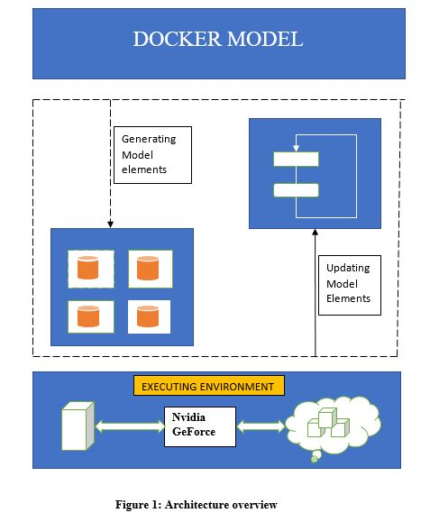
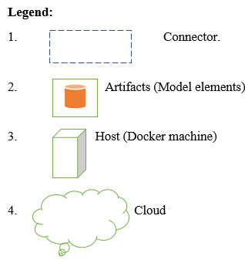
Architecture overview
3 Layers
Docker model (engine)
Container services layers
Execution Environment

Slide 4
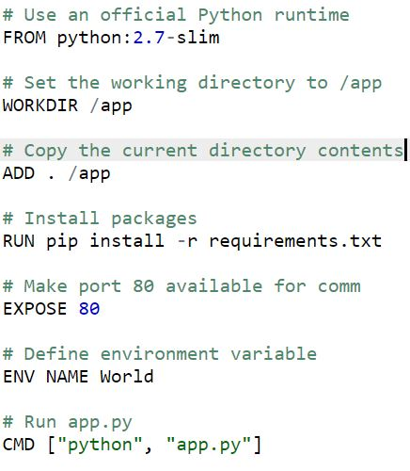
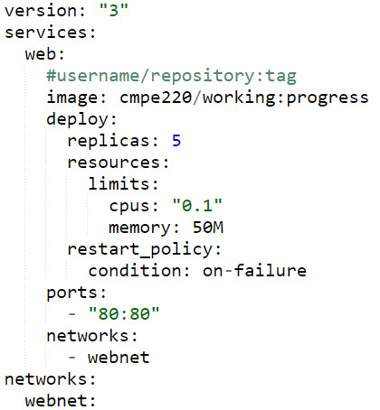
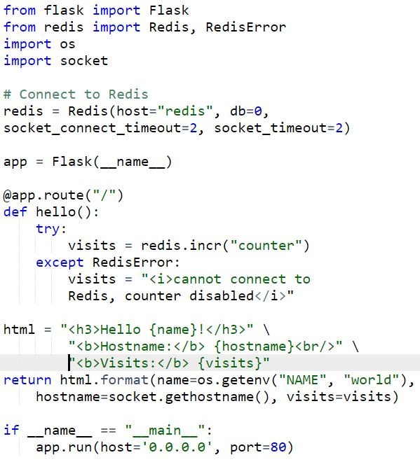

Web application (Hello world)
Hierarchy: Containers → Services → Swarms→ Stacks → Deployment
Docker file
Docker-compose.yml
App_code.py

Slide 5
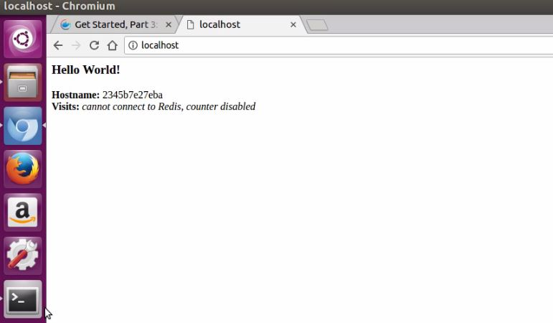

Continued…
Run the application
Running container
Initiate swarm
Connect multiple hosts
Scale up the application = 5

Slide 6
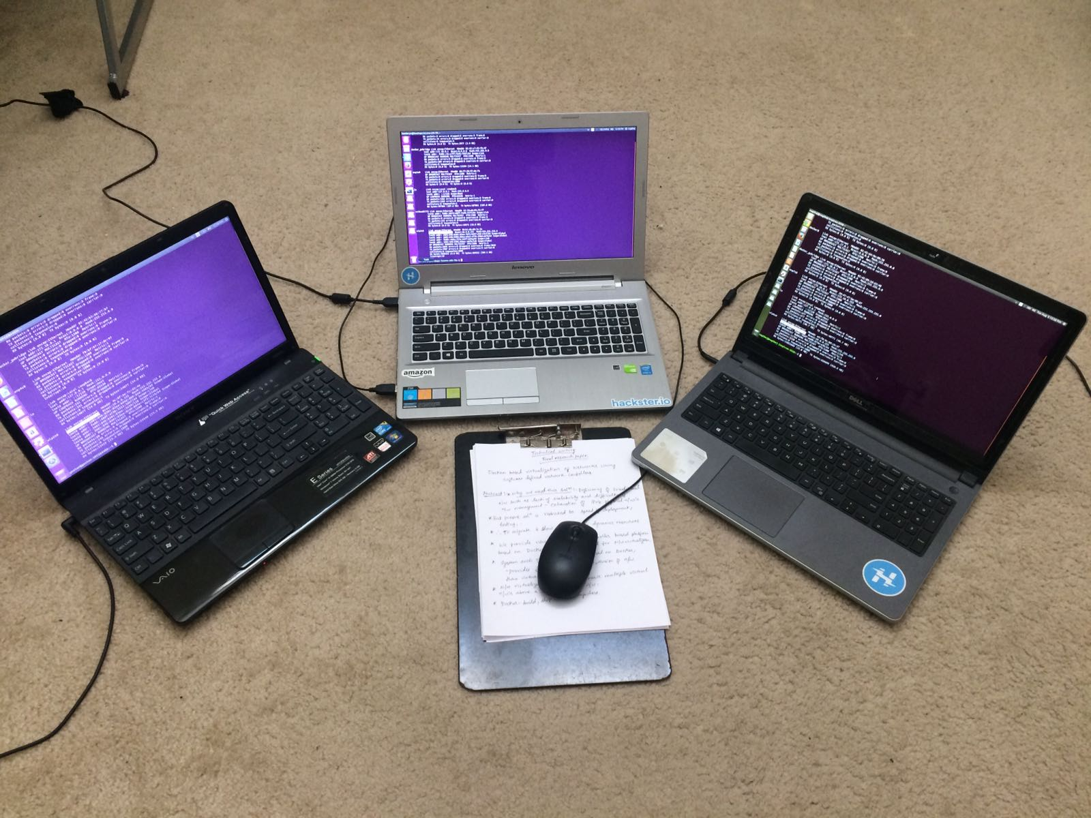
Experimental setup
10.0.0.221 (Lenovo, Nvidia-Geforce 840M)
10.0.0.30 (Sony, Ubuntu)
10.0.0.183 (Dell, Ubuntu)

Slide 7
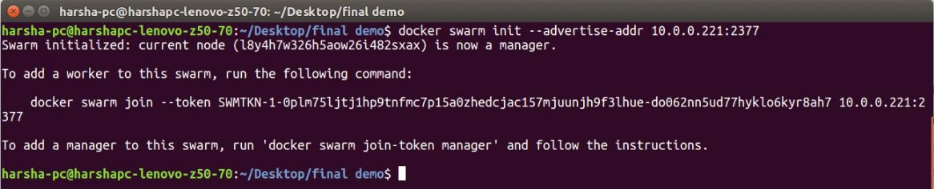
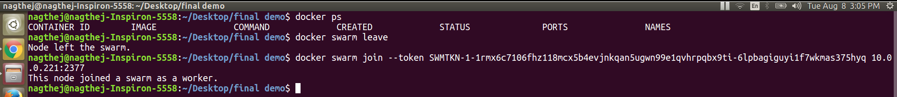
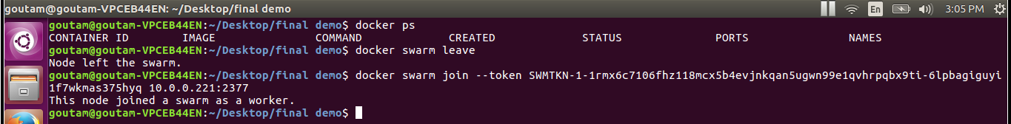
Swarm, connecting Nodes..
Initiate swarm manager (IP: 10.0.0.221)
Join 10.0.0.183 to swarm
Join 10.0.0.30 to swarm to form a cluster

Slide 8
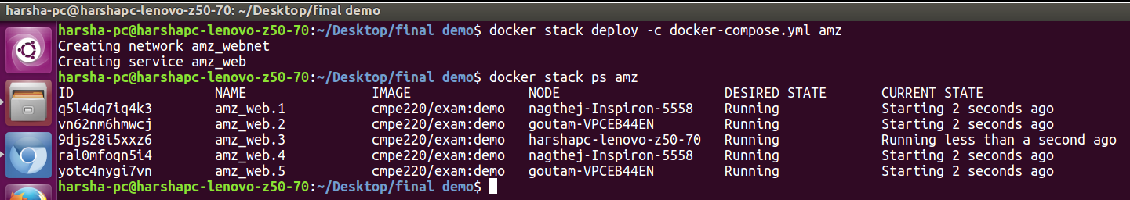
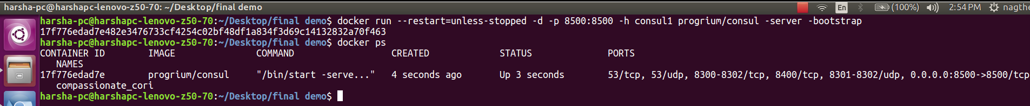

Add services to cluster (Visualizer)
Create 5 replicas of container and view the load balancing among 3 nodes
Run Discovery service called consul in backend

Slide 9
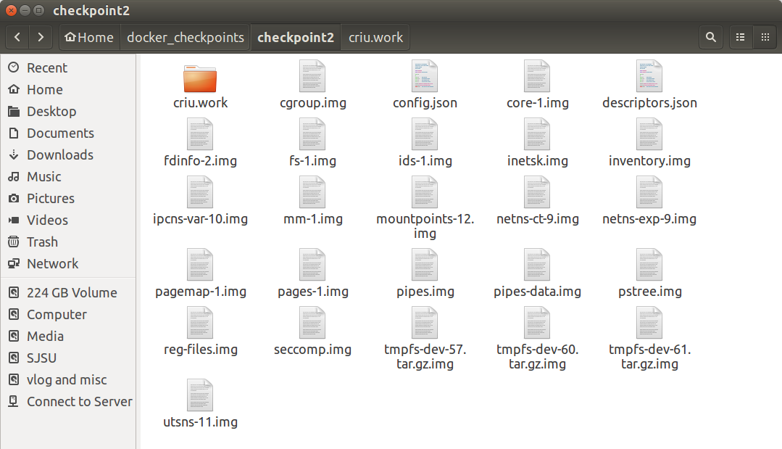
Checkpoint (Dump the manager container)
Create Checkpoint
Dumped files
Contains all files in form of images
File descriptors
cgroups
Mounts
TCP connections

Slide 10
Restore to other nodes
Use rsync to copy files remotely to other hosts (can use shared file systems also)
Restored into other existing nodes
Next steps
Test Container migration
Stop container on manager node
Observe transfer of leadership from 10.0.0.221 to 10.0.0.30
Stop container in 10.0.0.30 and container is automatically up in the only remaining healthy node 10.0.0.183

Slide 11
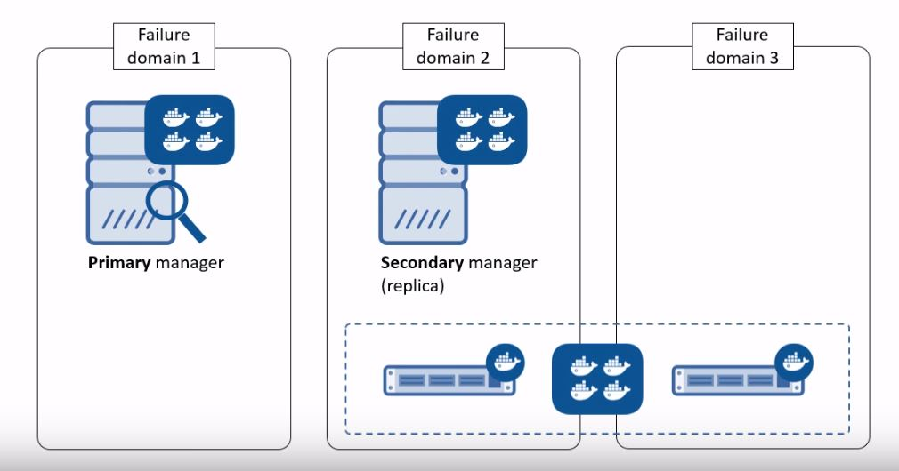
Container migration

Slide 12
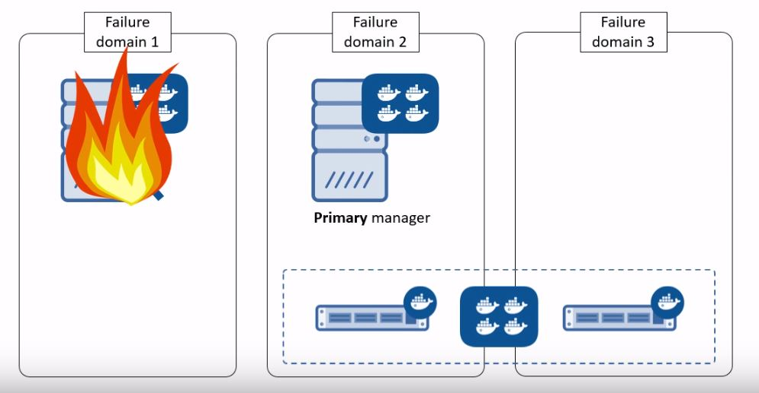
Primary is down, Leadership transferred to secondary

Slide 13
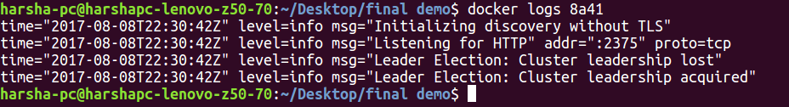
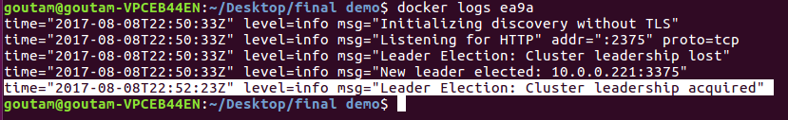
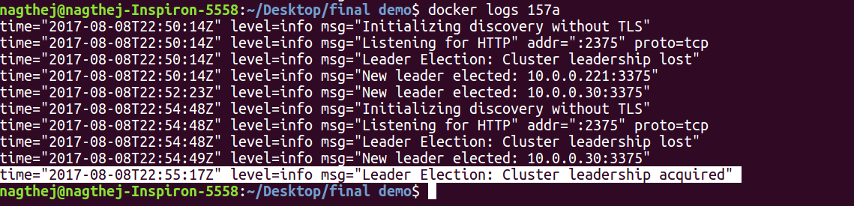
High Availability
10.0.0.221
10.0.0.30
10.0.0.183

Slide 14


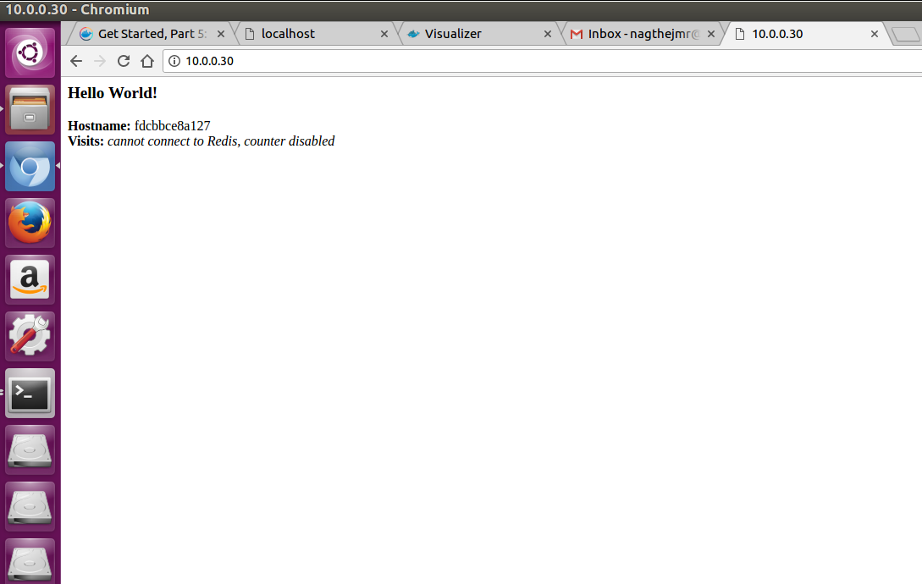
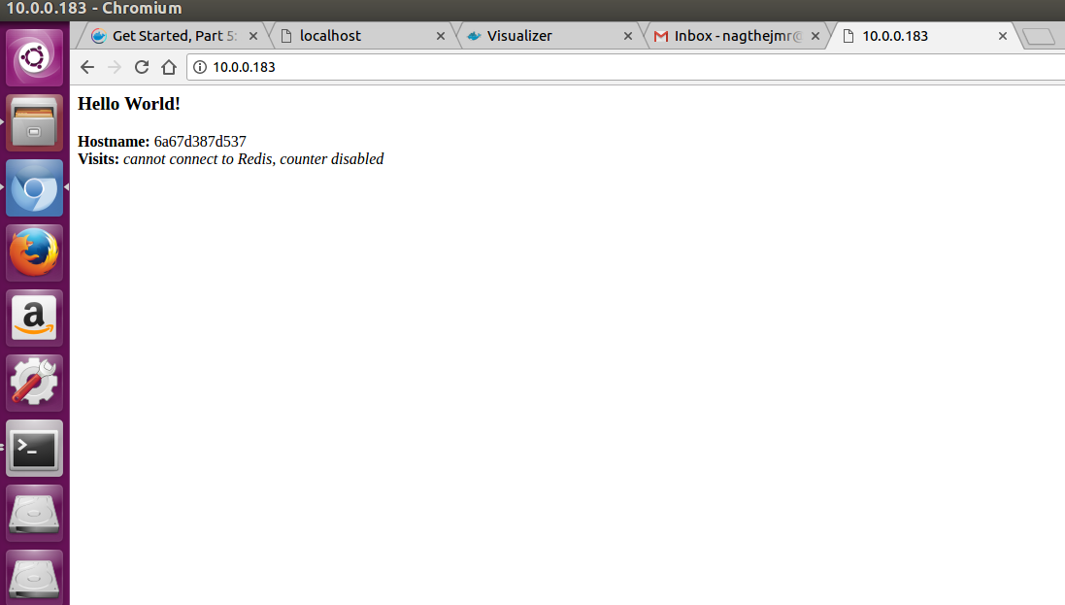



High Availability of Web app container

Slide 15
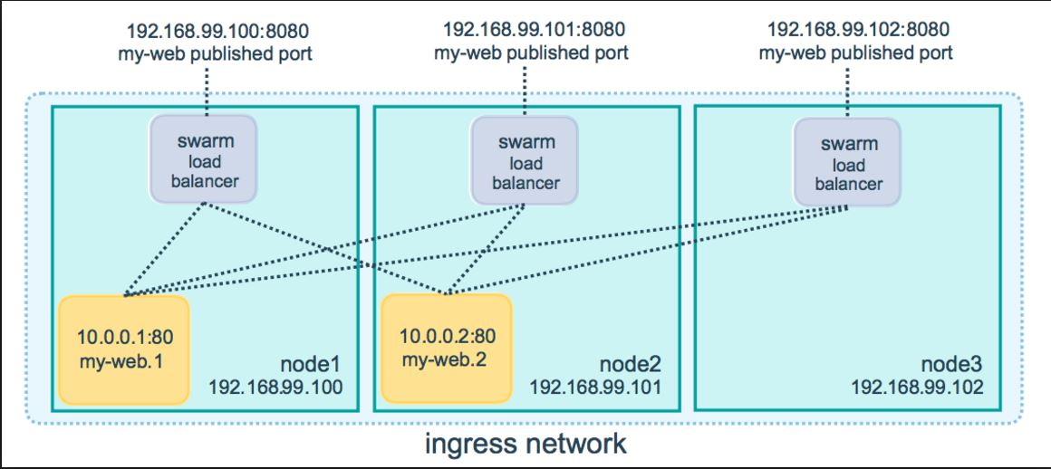
Ingress routing mesh..
The reason why both IP address work is that nodes in the swarm participate in ingress routing mesh.
This ensures that a service deployed at a certain port within your swarm always has that port reserved to itself.

Slide 16
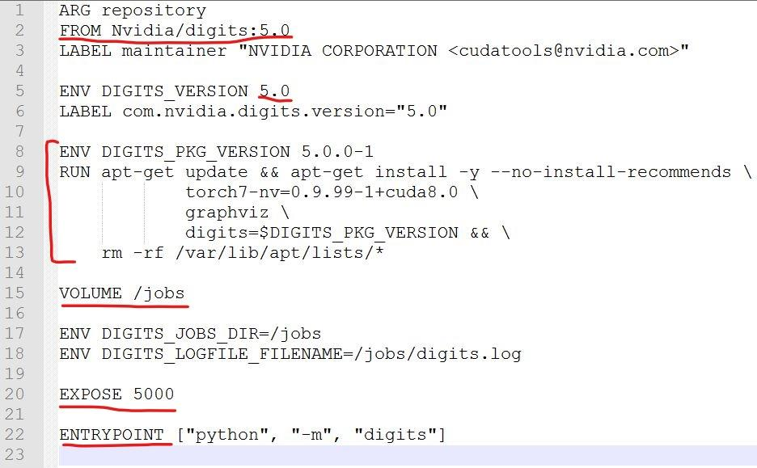
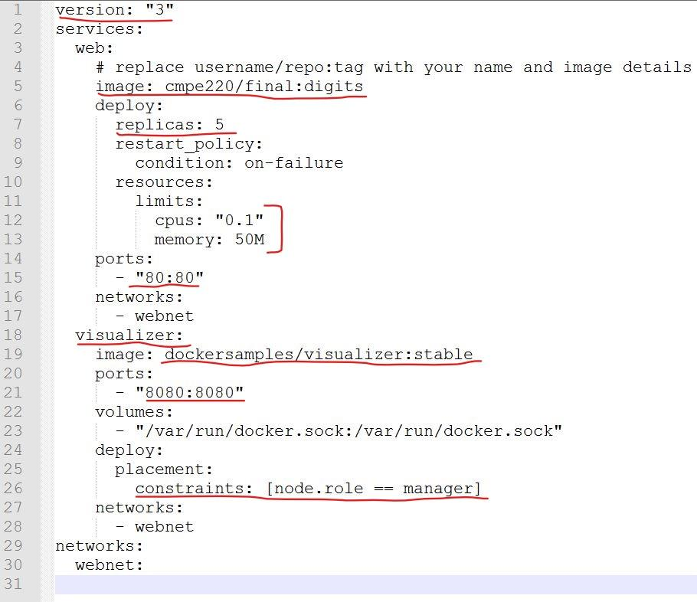
Nvidia-DIGITS Container
Hierarchy: Containers → Services → Swarms→ Stacks → Deployment
Dockerfile
Docker-compose.yml

Slide 17
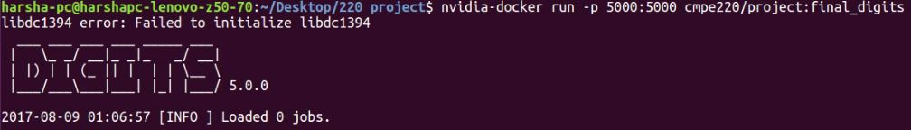
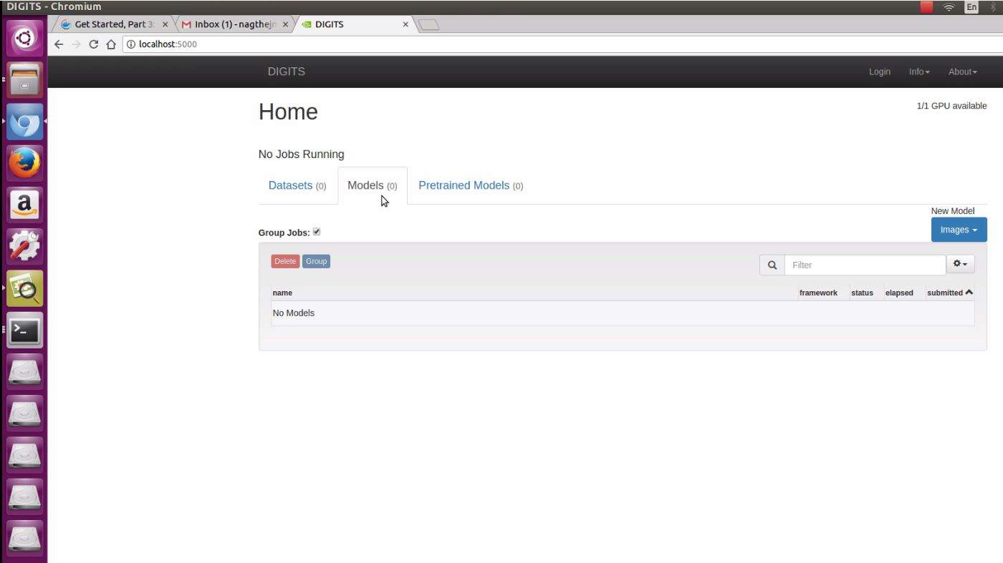
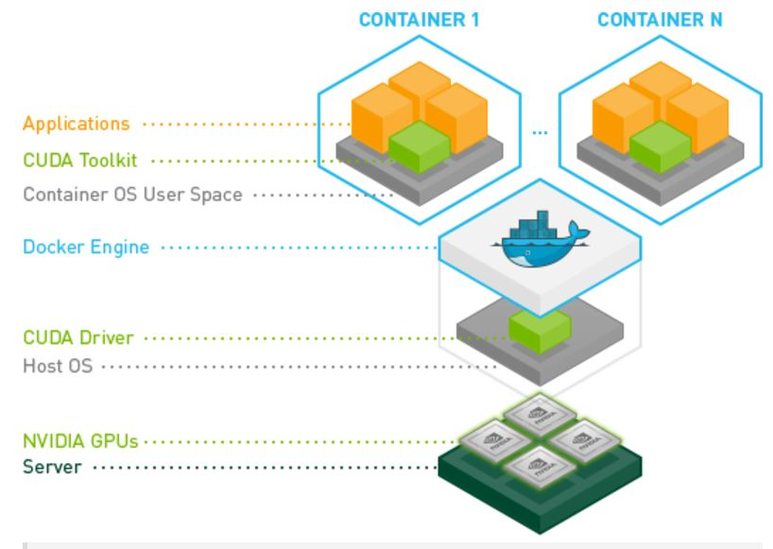

DIGITS
Running DIGITS inside container
Localhost:5000

Slide 18
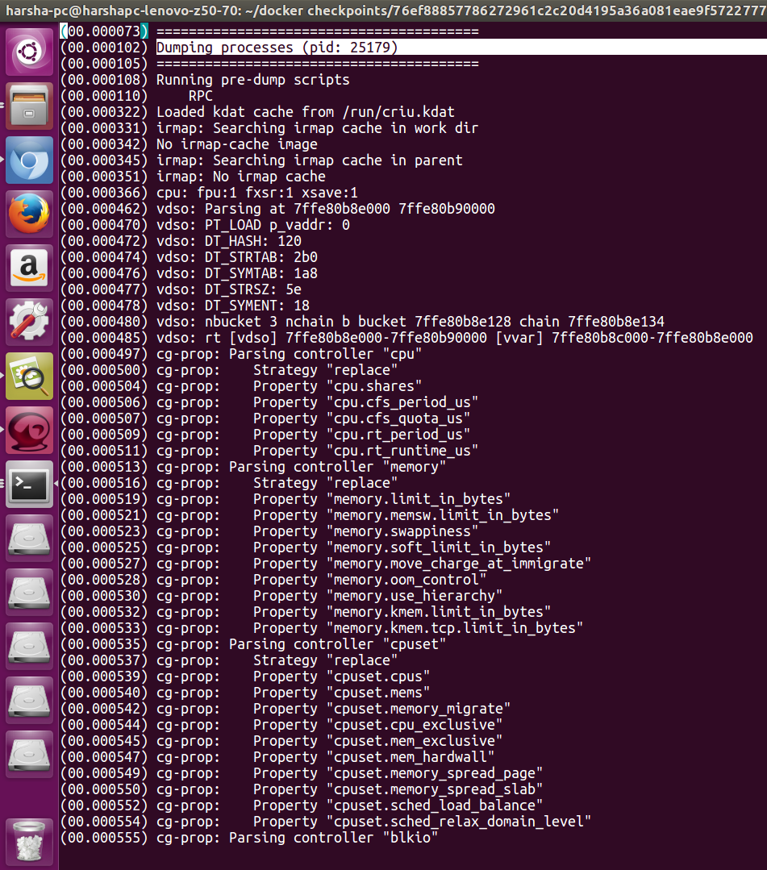
Dump operation
Initiated dump
CRIU
Obtain file descriptors, mounts, cgroups, TCP connections
Acquired CPU info, memory, cpuset
Lazy migration

Slide 19
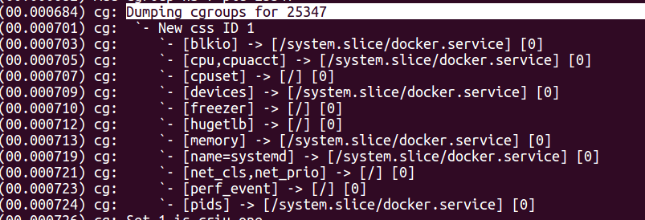
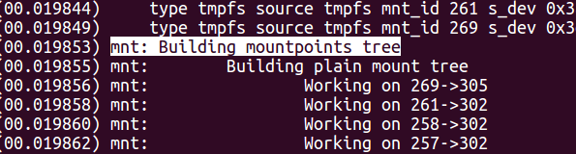
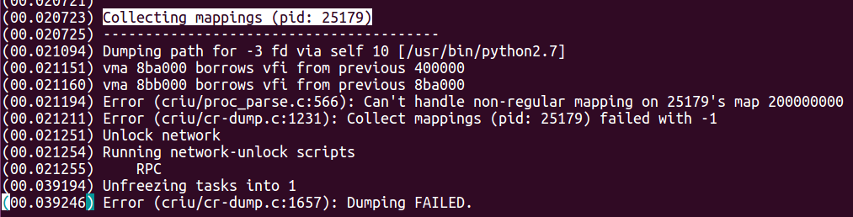

Errors fixed while dumping
Enable cgroups access for DIGITS pid Provided external mount storage
Mapping function returning value -1 (error). Dump failed!

Slide 20

Application
OpenCV
Open Source Computer Vision Library is an open source computer vision and machine learning software library
Features
The library has more than 2500 optimized algorithms.
It has C++, C, Python, Java and MATLAB interfaces and supports Windows, Linux, Android and Mac OS. Nvidia platforms are also supported.
Notes:
At the beginning, we were going to apply some image processing applications on the Jetson by using opencv. Because opencv has very large number of open source libraries for image processing and machine learning. In addition, opencv can run perfectly on the NVIDIA platform.

Slide 21
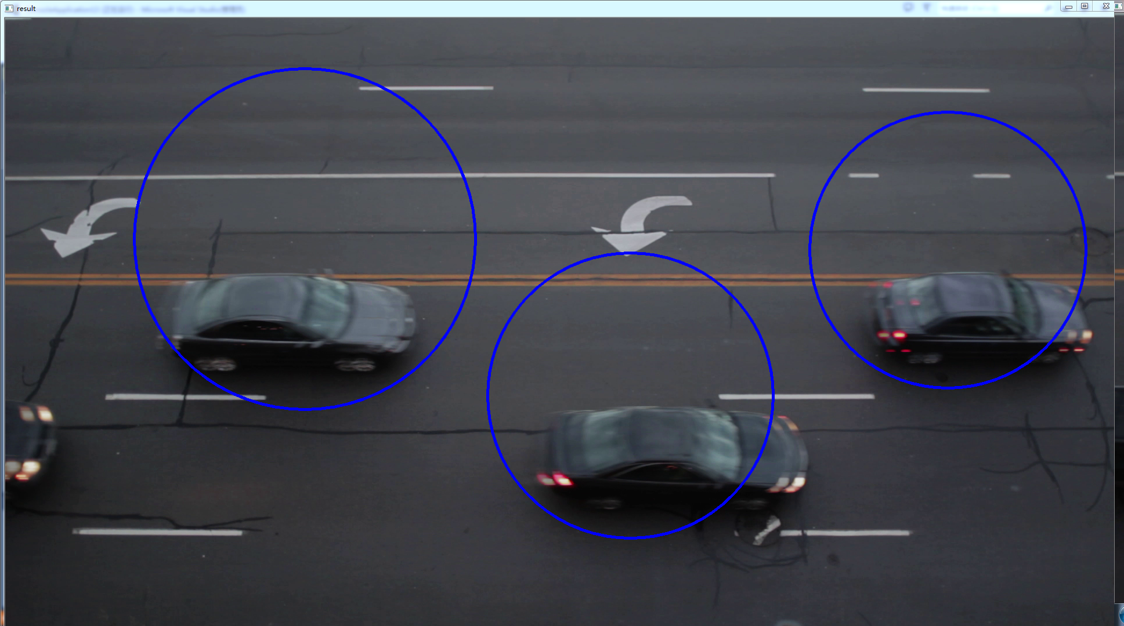
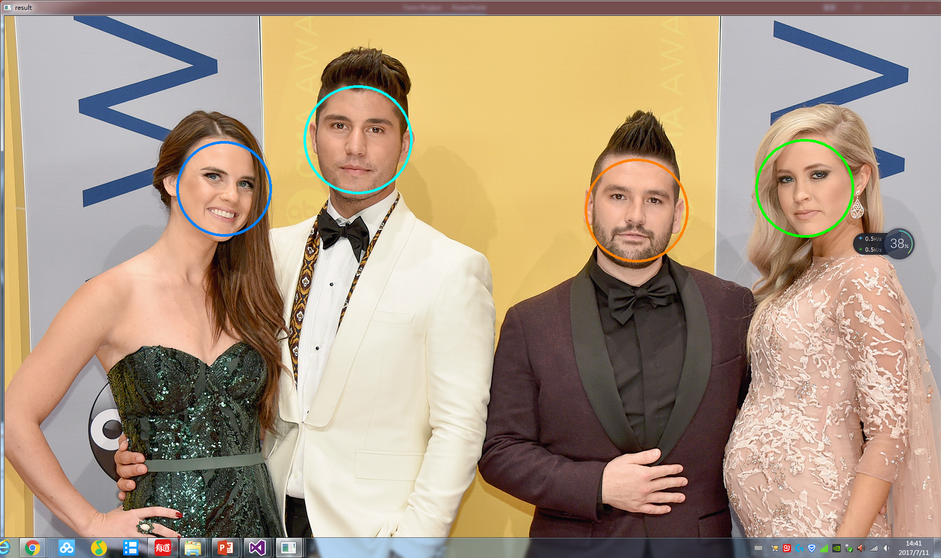
OpenCV
Face detection
Car detection
Notes:
This is the result of our previous programs.

Slide 22
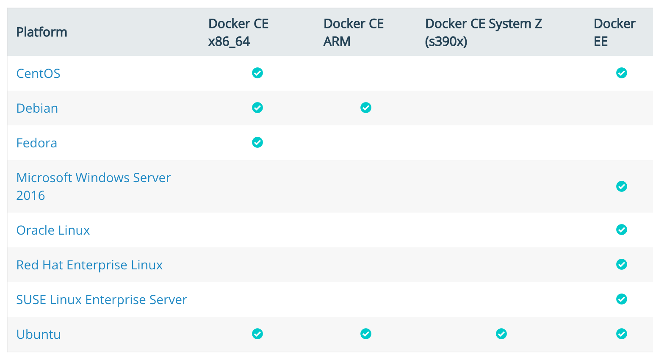
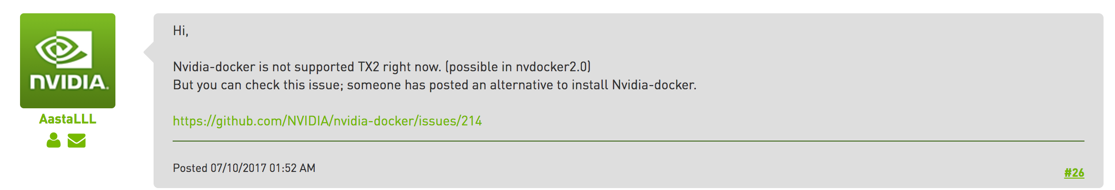
Problem
Docker
Docker is supported on Ubuntu on x86_64, armhf, and s390x (IBM z Systems) architectures. Aarch64(Jetson TX2) is not supported.
Solutions
Although many people try to use Docker on Jetson, there is no perfect and stable solution at the moment.
Notes:
But we have found a very serious problem. From what we have found on Internet, the problem can not be solved very well at the moment. The reply in the bottom right picture comes from the official technician of Nvidia. The architecture in Jetson TX2 is not supported by Docker.

Slide 23
NVIDIA Digits 5
What is DIGITS
The NVIDIA Deep Learning GPU Training System (DIGITS) puts the power of deep learning into the hands of engineers and data scientists. DIGITS can be used to rapidly train the highly accurate deep neural network (DNNs) for image classification, segmentation and object detection tasks.
What’s New in DIGITS 5
Train Image Segmentation neural networks to partition images into regions such as tumors from healthy tissue, and buildings and cars from free space
Decrease training time and improve model accuracy by starting with pre-trained models such as AlexNet, GoogLeNet and others from the DIGITS Model Store
Notes:
Therefore, we decided to use Nvidia‘s Digits for image classification and processing. Digits is the abbreviation of Deep Learning GPU Training System. Digits provides a very convenient and simple UI to help us classify, segment and recognize images. In DIGITS Model Store, you can download a variety of already trained models. Compared to opencv, Digits greatly reduces programming workload. Most of the time, we don't need to program on the digits.

Slide 24
Cont.
Key features
Design, train and visualize deep neural networks for image classification, segmentation and object detection
Download pre-trained models such as AlexNet, GoogLeNet and LeNet from the DIGITS Model Store
Perform hyperparameter sweep of learning rate and batch size for improved model accuracy
Schedule, monitor, and manage neural network training jobs, and analyze accuracy and loss in real time
Import a wide variety of image formats and sources
Scale training jobs across multiple GPUs automatically
Notes:
Here‘s what I think about the advantages of digits in image processing field. In short, digits efficiently and quickly uses single or multiple GPU to process and recognize images. In addition, digits provides several training models. We can easily schedule, monitor, and manage neural network training jobs, and analyze accuracy and loss in real time.

Slide 25
How to use DIGITS
Import data for image classification and object detection neural networks
Download pre-trained models such as AlexNet, GoogLeNet and LeNet from the DIGITS Model Store
Notes:
The operation of digits can be roughly divided into 6 steps. First, load the data. The second is to download and select the appropriate training model.

Slide 26
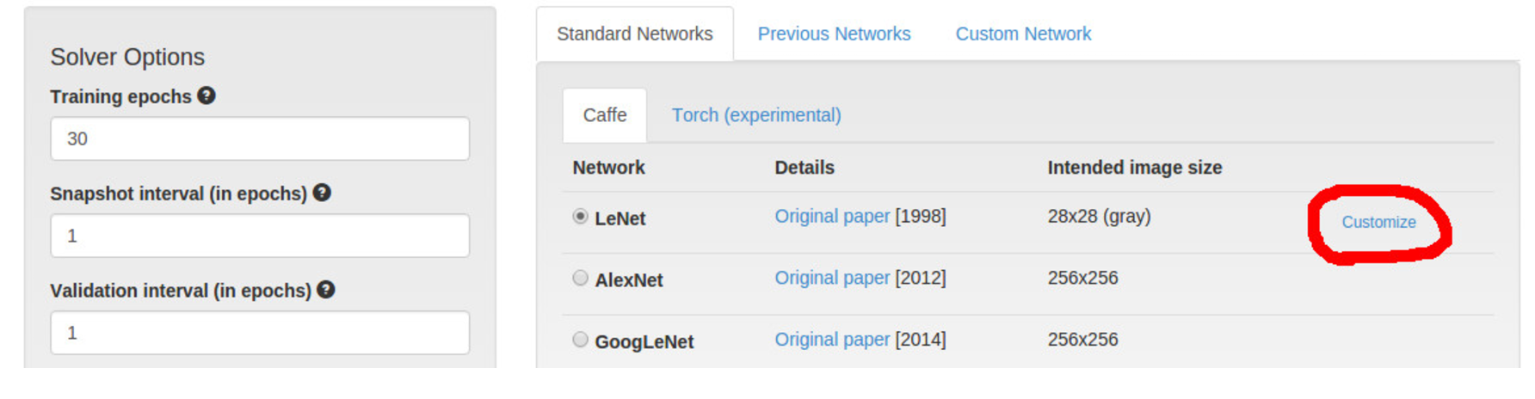
Cont.
Digits gives users the ability to define custom layer types in Python, instead of the usual C++/CUDA. This can be a very useful feature
That will take us to a pane where we can customize LeNet to add our custom Python layer. We are going to insert our layer in between the scale layer and the conv1 layer.
Notes:
It is worth mentioning that after you download the required model, Digits gives users the ability to define custom layer types in Python, instead of the usual C++/CUDA. This can be a very useful feature.

Slide 27
Cont.
Visualize deep neural network architectures
Schedule, monitor, and manage neural network training jobs
Notes:
After you select or customize the training model you use, you can visualize it. The picture on the left will change depending on the model you selected and the custom content. The picture on the right is the interface of the operation.

Slide 28
Cont.
Analyze accuracy and loss in real time
Visualization of inference results
Notes:
Eventually, we'll get the results of the image processing.

Slide 29
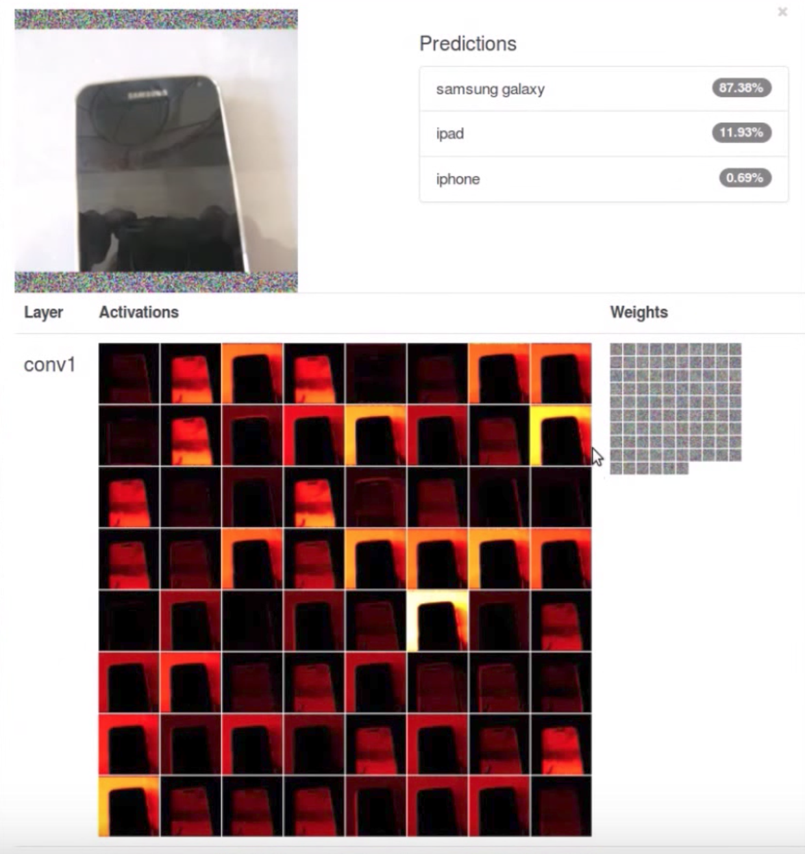
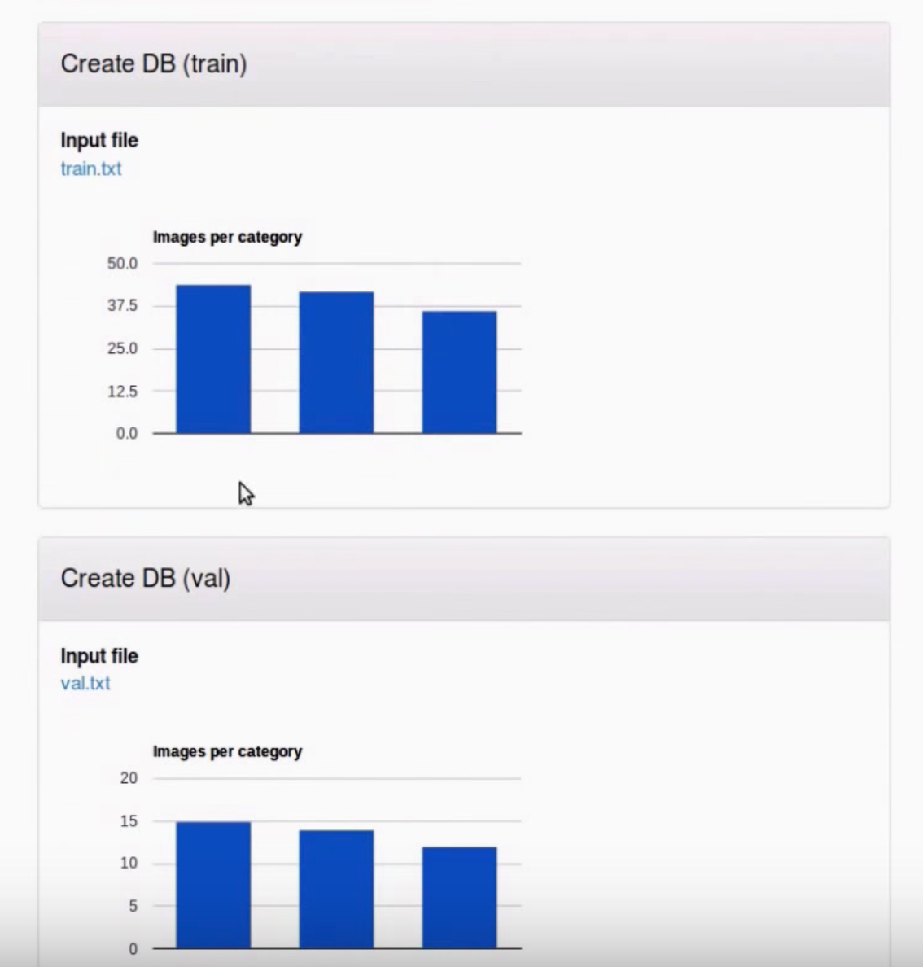
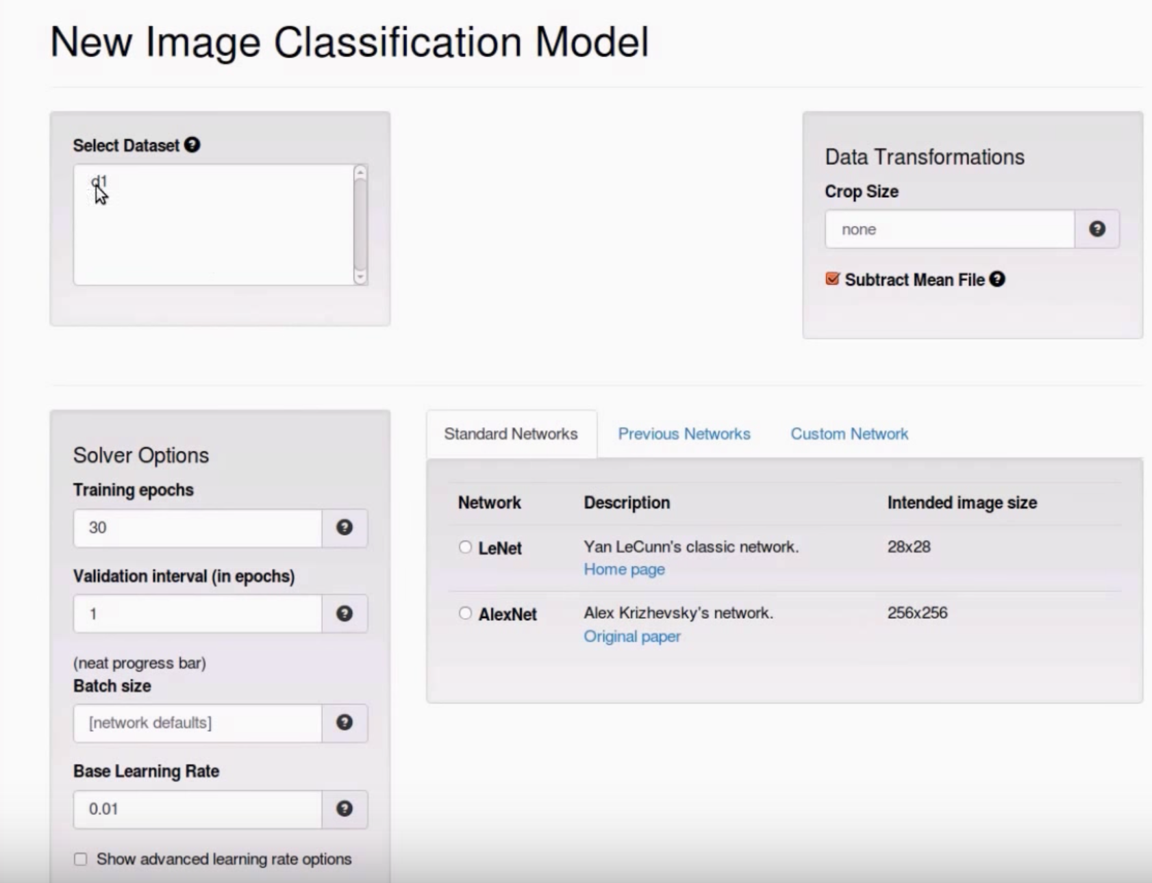
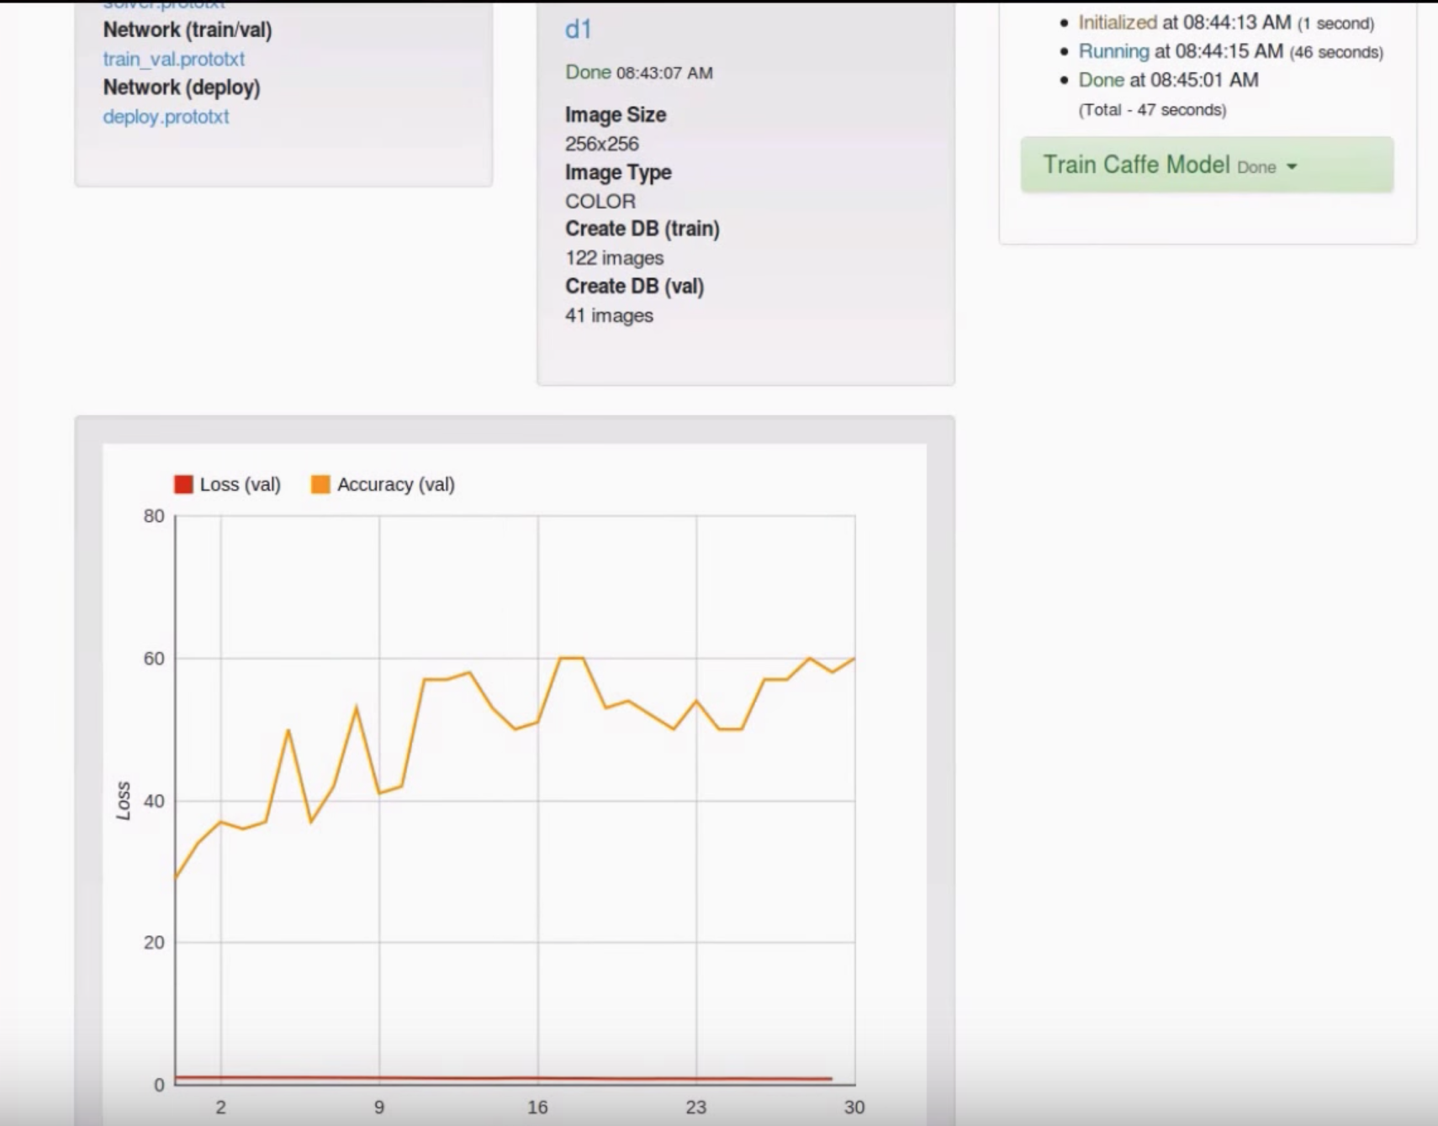
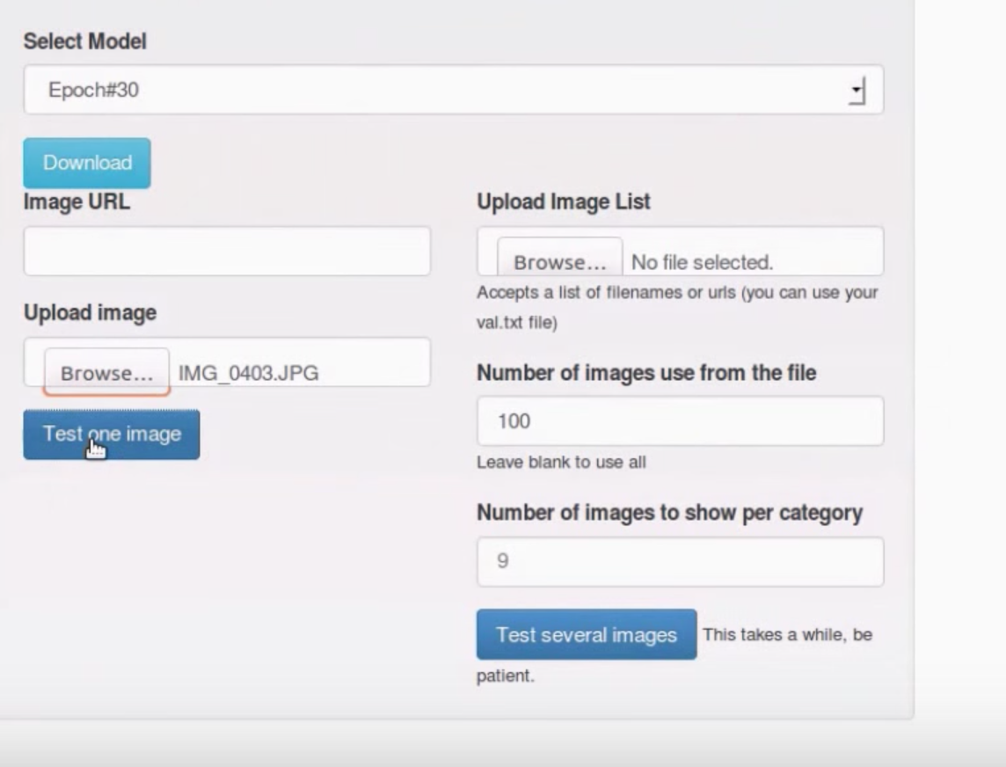
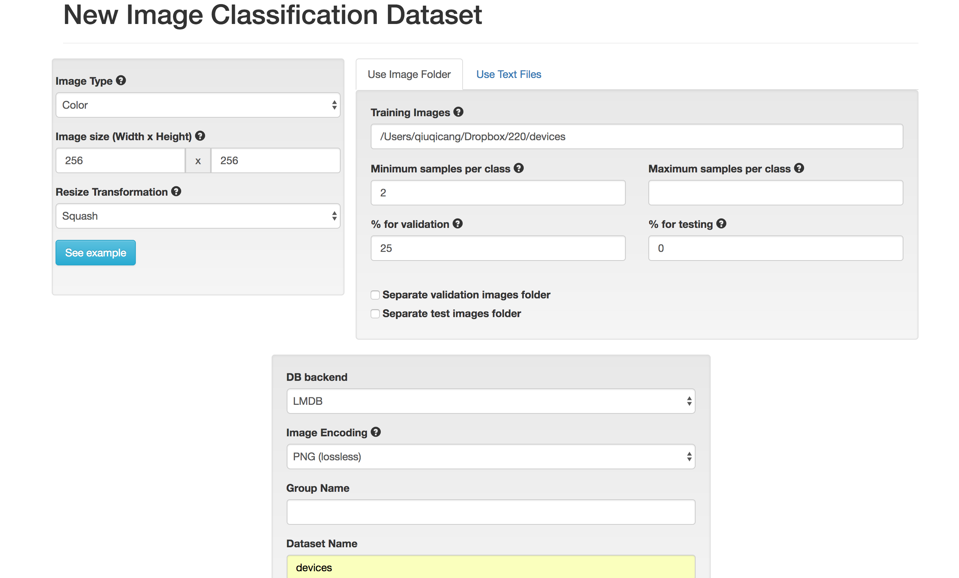
Example
Our dataset consists of around 150 photographs which are Iphones, Ipads and the Samsung Galaxy. (50 each)
We use Digits to implement cell phone type identification. 75% of pictures were used for learning.
We then tested the model on four pictures which were found on Google images. The model did well on all of them getting all four classifications correct.
Notes:
We also experimented with simple image classification using digits. We choose 150 pictures of 3 different mobile phones, each with 50 pictures. 75% of the images were used as training sets, and 25% of the remaining pictures were used to test the accuracy of the results. In addition, we downloaded the pictures of these three mobile phones randomly from the Internet and classified them by digits. The model did well on all of them getting all four classifications correct.

Slide 30
Learnings
Emerging Research area – Container migration
Full stack dev of an application
New Virtualization technology – Docker, LXC
Concepts of IP addresses & ports, VM’s, Editing config files
How to fix code dependencies and building
Jetson Tx2 – From ssh to Installing custom kernel module

Slide 31
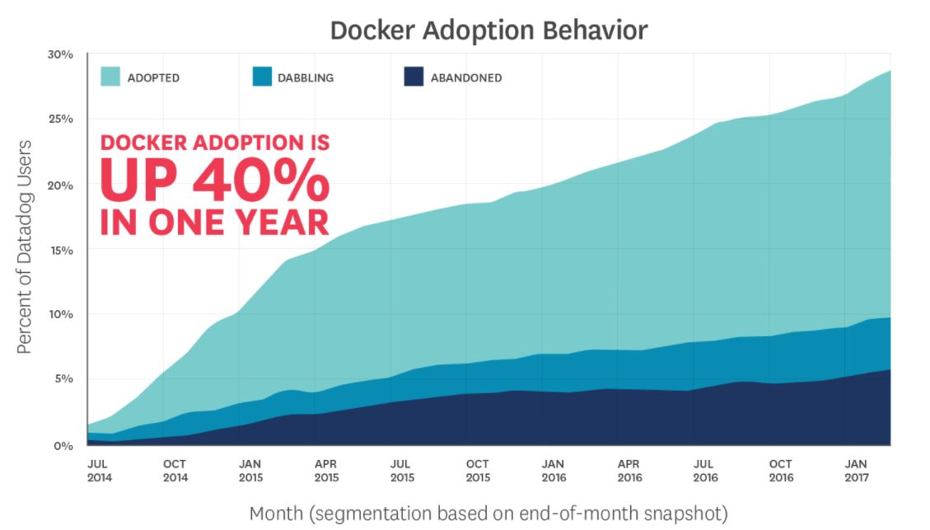
Docker Trend

Slide 32
References:
Official Docker documentation: https://docs.docker.com/
Official Nvidia Forum: https://devtalk.nvidia.com/default/topic/1000224/jetson-tx2/dockeron-the-tx2/1
Wubin Li and Ali Kanso, Comparing Containers versus Virtual Machines for Achieving High Availability, 2015 IEEE International Conference on Cloud Engineering.
Jain, R., Kasturi, R., & Schunck, B. G. (1995). Machine vision (Vol. 5). New York: McGrawHill.
Woo, K. H., Yang, T. Y., Park, K. J., & Lee, C. (2000). Robust voice activity detection algorithm for estimating noise spectrum. Electronics Letters, 36(2), 180-181.
Osuna, E., Freund, R., & Girosit, F. (1997, June). Training support vector machines: an application to face detection. In Computer vision and pattern recognition, 1997. Proceedings., 1997 IEEE computer society conference on (pp. 130-136). IEEE

Slide 33
Thank you!

